Slide 1
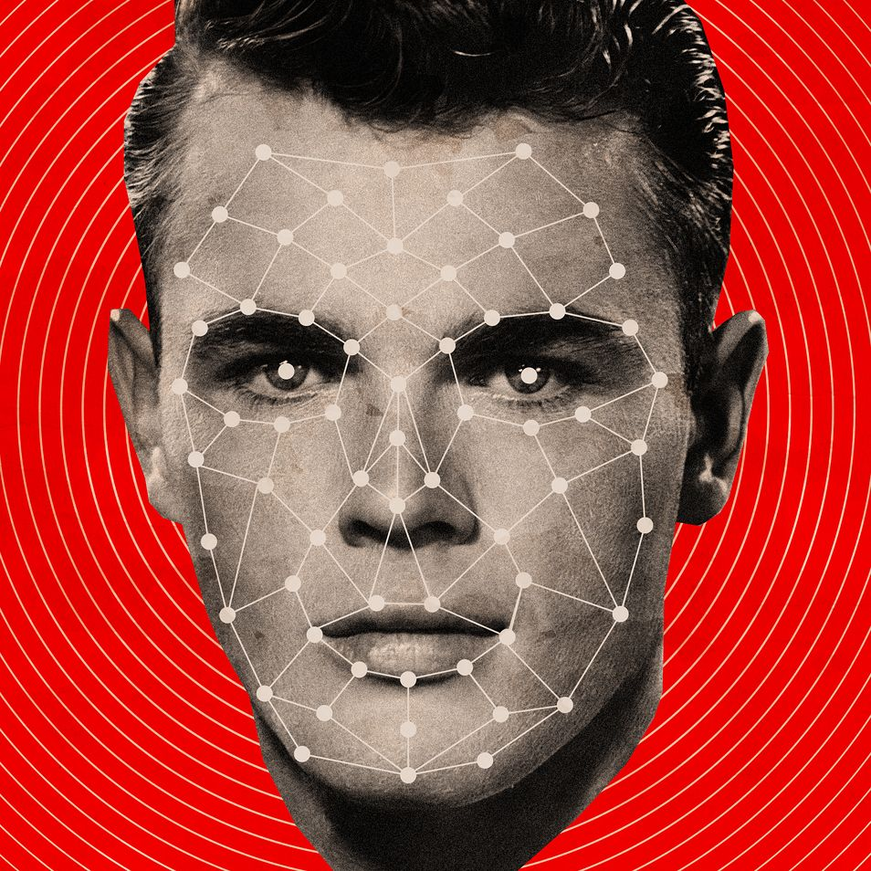

Innovative Project Department of Computer Science and Engineering Topic – Facial Recognition for Surveillance Team Argus
Submitted By
Deeptangshu Saha Enrollment No. 12021002029109 Bhaskar Das Enrollment No. 12021002029110 Nilay Mukherjee Enrollment No. 12021002029112 Himadri Dutta Enrollment No. 12021002029104 Ankit Kumar Enrollment No. 12021002029111 Shubhayu Mandal Enrollment No. 12021002029154 Rupam Ghosh Enrollment No. 12021002029113 Shantanu Bera Enrollment No. 12021002029141 Naimur Hossaion Sk Enrollment No. 12021002029080 Sampad Narayan Bhattacharjee Enrollment No. 12021002029106

Slide 2
Acknowledgment
We would like to take this opportunity to thank everyone whose cooperation and encouragement throughout the ongoing course of this project remains invaluable to us. We are sincerely grateful to our guide Prof. Sandip Mandal and Prof. Debaleena Datta of the Department of Computer Science and Engineering, UEM, Kolkata, for their wisdom, guidance and inspiration that helped us to go through with this project and take it to where it stands now. Last but not the least, we would like to extend our warm regards to our families and peers who have kept supporting us and always had faith in our work.

Slide 3
Problem Statement
It is clear from the title that we are going to use facial recognition in helping us to conduct surveillance. Now ’Surveillance’ is a rather sensitive topic because people always co-relate surveillance with unlawful monitoring as well as breach of privacy. So for now in this document by surveillance we will mean strictly the public streets where CCTV for monitoring purposes are accepted by all as lawful and ethical surveillance. We are going to use our product ’Sharingan’ duly meaning the ’copy eye’ as it’s in the initial stages we are using it to identify the limited people in the database thus just copying the face and matching it with the database to identify whether they are in the database and identify if present in the database.

Slide 4
Proposed Solution
We are using the OpenCV library in python and using it for both computer vision as well as facial recognition. It uses CNN for training its models and recognizing faces. We used the CNN algorithm as because the size of the database as well as the speed of the algorithm for less data is quite high which in turn speeds up the process by a lot. We also made sure to lessen the time taken by creating pre encode pictures so that it does not do it every time the program runs.

Slide 5
Experiment Setup & Result Analysis
import cv2
import face_recognition
import numpy as np
# from simple_facerec import SimpleFacerec
# Encode faces from a folder
# sfr = SimpleFacerec()
# sfr.load_encoding_images("images/")
frame_resizing = 0.25
def detect_known_faces(frame):
small_frame = cv2.resize(frame, (0, 0), fx=frame_resizing, fy=frame_resizing)
# Find all the faces and face encodings in the current frame of video
# Convert the image from BGR color (which OpenCV uses) to RGB color (which face_recognition uses)
rgb_small_frame = cv2.cvtColor(small_frame, cv2.COLOR_BGR2RGB)
face_locations = face_recognition.face_locations(rgb_small_frame)

Slide 6
face_encodings = face_recognition.face_encodings(rgb_small_frame, face_locations)
known_face_encodings = np.load('ImageEncoding.npy')
image_names = open("ImageNames.txt", "r")
known_face_names = []
for known_face_names_var in image_names:
known_face_names.append(known_face_names_var)
face_names = []
for face_encoding in face_encodings:
# See if the face is a match for the known face(s)
matches = face_recognition.compare_faces(known_face_encodings, face_encoding)
name = "Unknown"
# # If a match was found in known_face_encodings, just use the first one.
# if True in matches:
# first_match_index = matches.index(True)
# name = known_face_names[first_match_index]
# Or instead, use the known face with the smallest distance to the new face
face_distances = face_recognition.face_distance(known_face_encodings, face_encoding)
best_match_index = np.argmin(face_distances)
if matches[best_match_index]:
name = known_face_names[best_match_index]
face_names.append(name[:-1])
# Convert to numpy array to adjust coordinates with frame resizing quickly

Slide 7
face_locations = np.array(face_locations)
face_locations = face_locations / frame_resizing
return face_locations.astype(int), face_names
# Load Camera
cap = cv2.VideoCapture(0)
while True:
ret, frame = cap.read()
# Detect Faces
face_locations, face_names = detect_known_faces(frame)
for face_loc, name in zip(face_locations, face_names):
y1, x2, y2, x1 = face_loc[0], face_loc[1], face_loc[2], face_loc[3]
cv2.putText(frame, name,(x1, y1 - 10), cv2.FONT_HERSHEY_DUPLEX, 1, (0, 0, 200), 2)
cv2.rectangle(frame, (x1, y1), (x2, y2), (200, 0, 0), 4)
cv2.imshow("Frame", frame)
key = cv2.waitKey(1)
if key == 27:
break
cap.release()
cv2.destroyAllWindows()

Slide 8
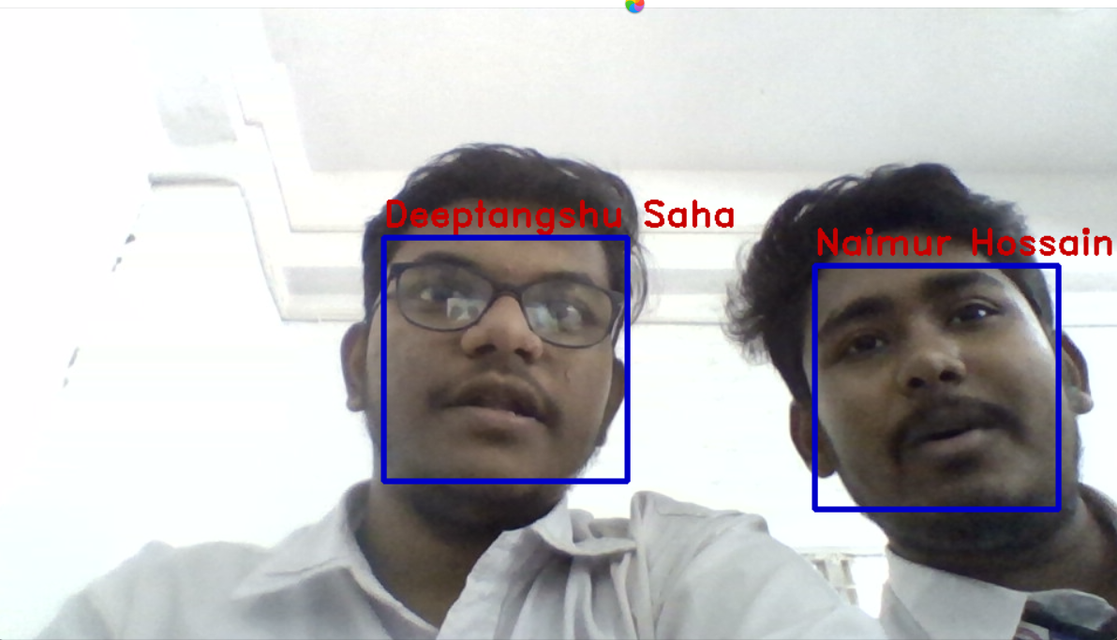
OUTPUT

Slide 9
The above is the driver code and works as expected. Though the code works as expected it also identifies the faces which are in the database with an accuracy of more than 99%. The only drawback being that the face size needs to be of a certain size or it won’t detect the face at all. However the current distance is not so ideal and thus it needs to be improved further.

Slide 10
Conclusion & Future Scope
The immediate improvements that are to be done is fixing the minimum distance issue as the ideal distance is not so practical in a real world situation. And further down the road we will be seeing not only an advanced facial recognition surveillance system but for other purposes such as crime identification as well as possible criminal intent predictions.

